Slide 1

Maps of More Abstract Spaces

Slide 2
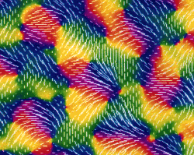
Orientation columns in the visual cortex

Slide 3
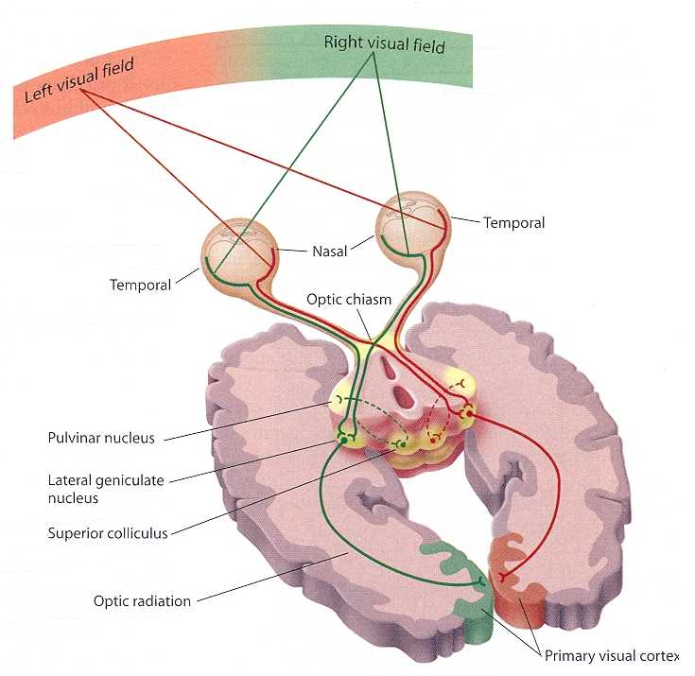
Visual cortex

Slide 4
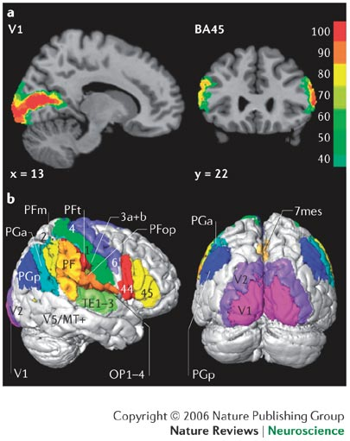
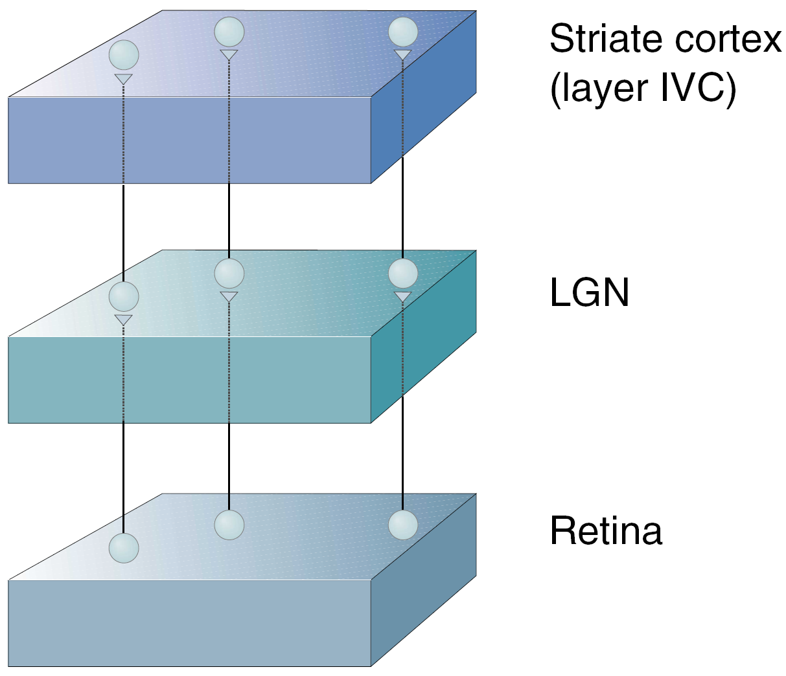
Visual Cortex
Primary visual cortex or striate cortex or V1. Well defined spacial representation of retina (retinotopy).

Slide 5
Visual Cortex
Primary visual cortex or striate cortex or V1. Well defined spacial representation of retina (retinotopy).
Prestriate visual cortical area or V2 gets strong feedforward connection from V1, but also strongly projects back to V1 (feedback)‏
Extrastriate visual cortical areas V3 – V5. More complex representation of visual stimulus with feedback from other cortical areas (eg. attention).

Slide 6
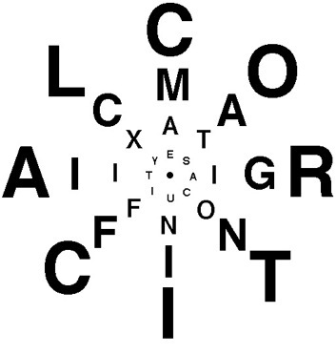

Slide 7
Visual cortex

Slide 8
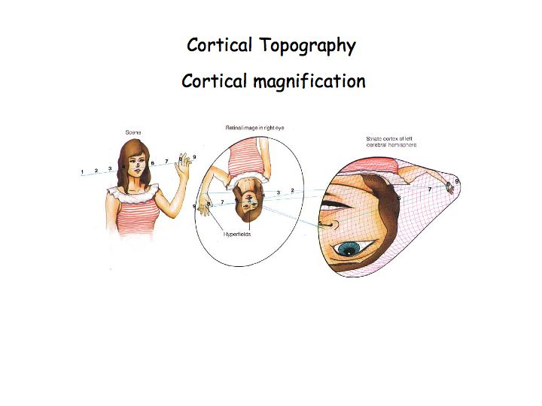
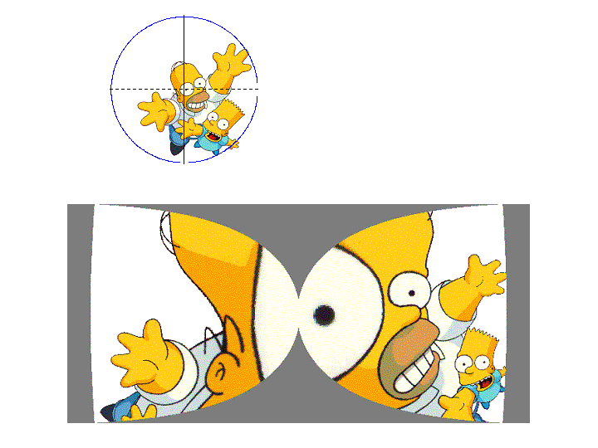
Cortical magnification

Slide 9
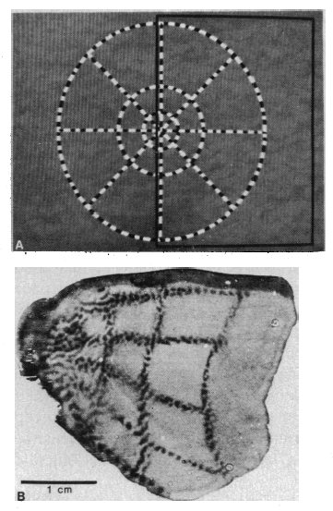
Mapping from retina to V1
Radioactive
2-deoxy-glucose
[Tootell 1982]
Stimulus
Photography of V1

Slide 10
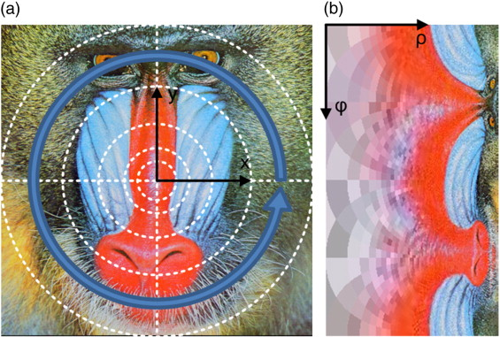
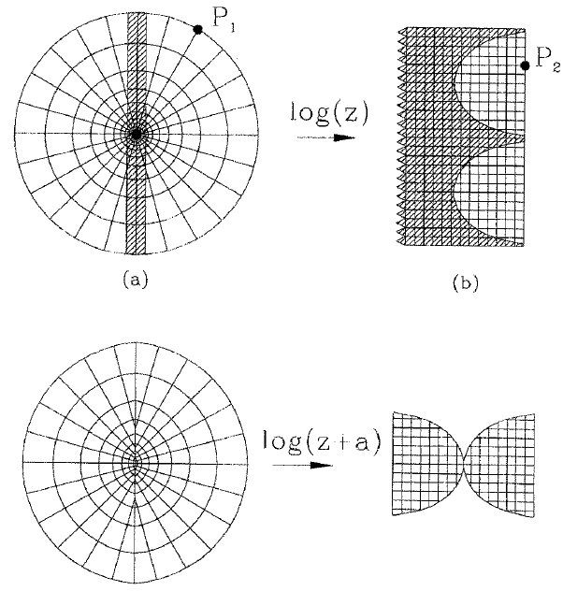
Mapping from retina to V1

Slide 11
Properties of the log z-transform
On „Invariance“
A major problem is how the brain can recognize object in spite of size and rotation changes!
Scaling and Rotation in Complex Polar Coordinates:
a_{retina} = x_{retina}+ iy_{retina} = r exp(iφ)
Scaling
A = k r exp(iφ) = k a
Rotation
Scaling constant
A = exp(iγ) r exp(iφ) = r exp(i[φ+γ]) = a exp(iγ)
Real Space log Z Space
Concentric Circles Vertical Lines
(expon. Spaced) (equally spaced)
Radial Lines Horizontal Lines
(equal anglular spacing) (equally spaced)
Rotation angle
After log Z transform we get:
Scaling:
log(ka) = log(k) + log(a)
Rotation:
log(a exp(iγ)) = iγ + log(a)
Thus we have obtained scale and rotation invariance of shapes !
They are only shifted.

Slide 12
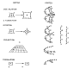
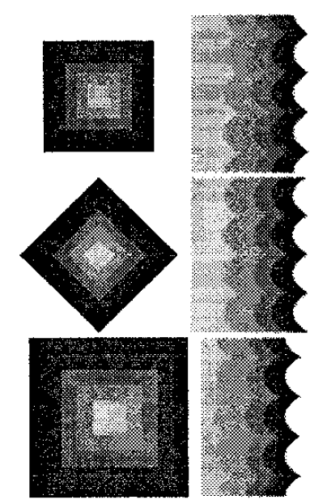

Properties of log z
[Schwartz, 1994]
[Araujo & Diaz 1997]

Slide 13
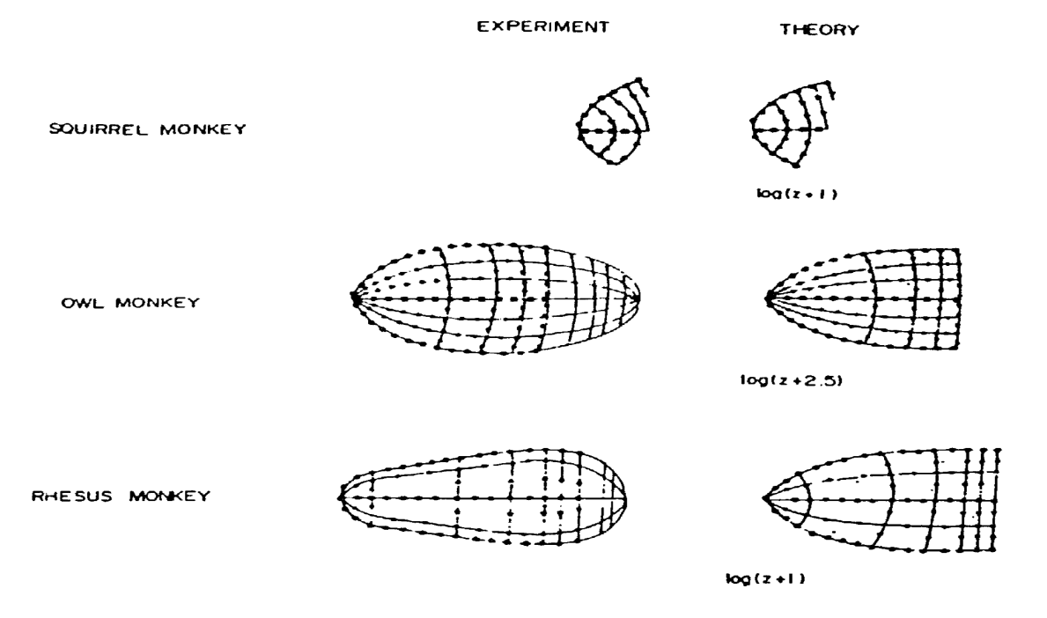
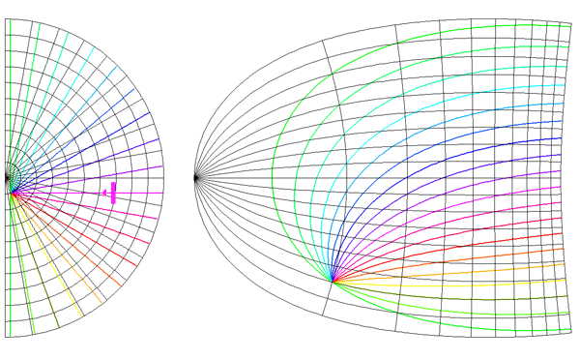
Real maps: log (z+a) and beyond
More realistic: converging angular lines at 90° (bean shaped map):
z+α
G(z) = log
z+β
z=x + iy
and β take the values
0.333 and 6.66 respectively.
For primates: α~0.3°, β∼50°
[Schwartz 1994]

Slide 14
Visual cortex

Slide 15
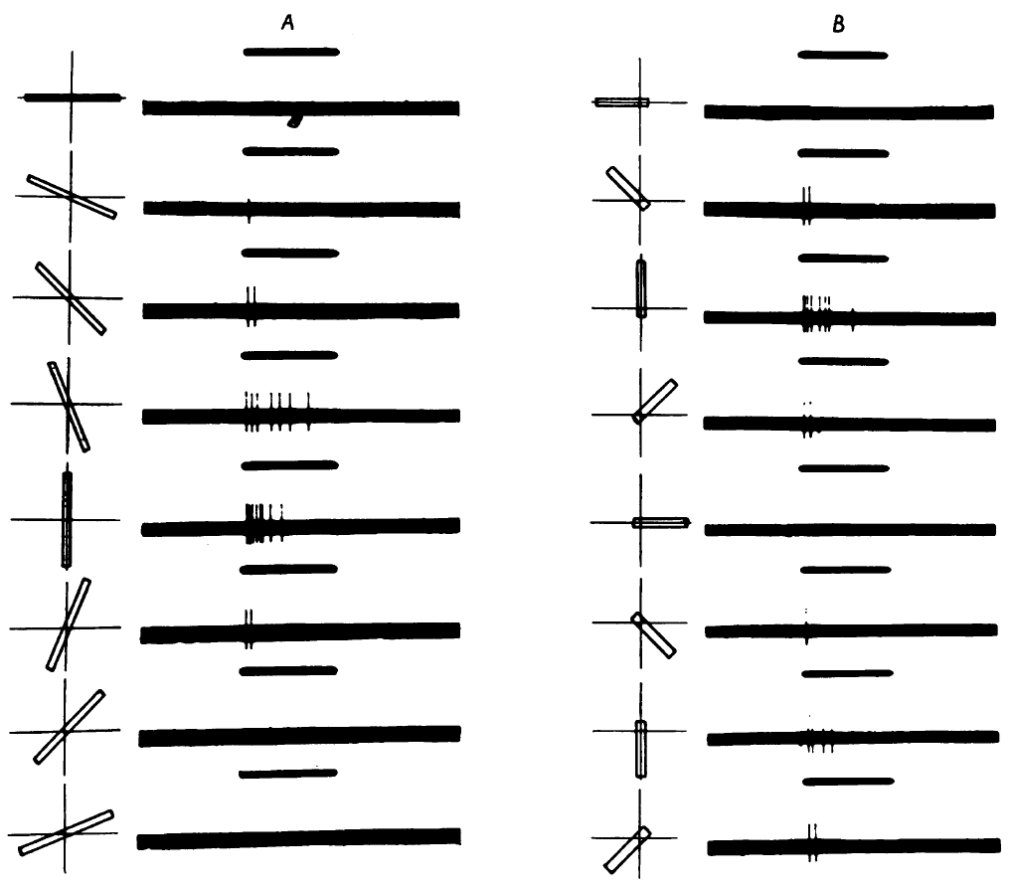
Receptive fields
Cells in the visual cortex have receptive fields (RF). These cells react when a stimulus is presented to a certain area on the retina, i.e. the RF.
Simple cells react to an illuminated bar in their RF, but they are sensitive to its orientation (see classical results of Hubel and Wiesel, 1959).
Bars of different length are presented with the RF of a simple cell for a certain time (black bar on top). The cell's response is sensitive to the orientation of the bar.

Slide 16
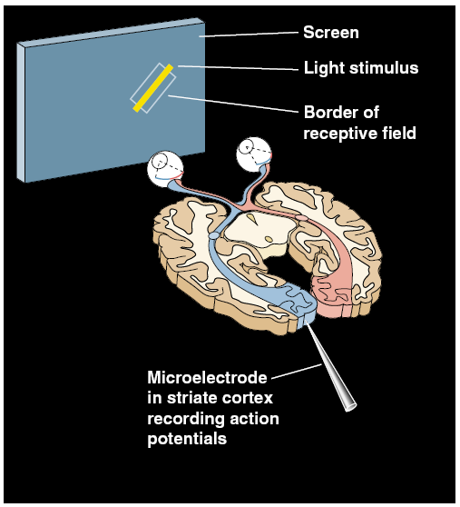
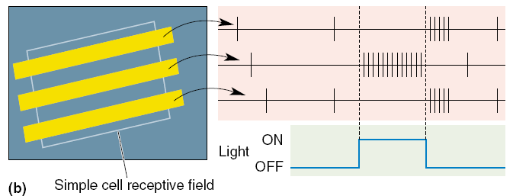
On-Off responses
Experiment: A light bar is flashed within the RF of a simple cell in V1 that is recorded from.
Observation: Depending on the position of the bar within the RF the cell responds strongly (ON response) or not at all (OFF response).

Slide 17
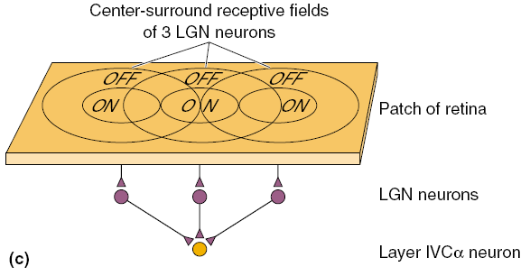
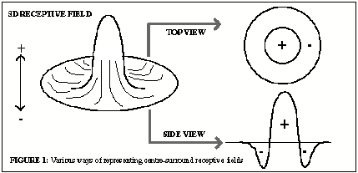
On-Off responses
Experiment: A light bar is flashed within the RF of a simple cell in V1 that is recorded from.
Observation: Depending on the position of the bar within the RF the cell responds strongly (ON response) or not at all (OFF response).
Explanation: Simple cell RF emerges from the overlap of several LGN cells with center surround RF.

Slide 18
Columns
Experiment: Electrode is moved through the visual cortex and the preference direction is recorded.
Observation 1: Preferred direction changes continuously within neighboring cells.

Slide 19
Columns
Experiment: Electrode is moved through the visual cortex and the preference direction is recorded.
Observation 1: Preferred direction changes continuously within neighboring cells.
Observation 2: There are discontinuities in the preferred orientation.

Slide 20
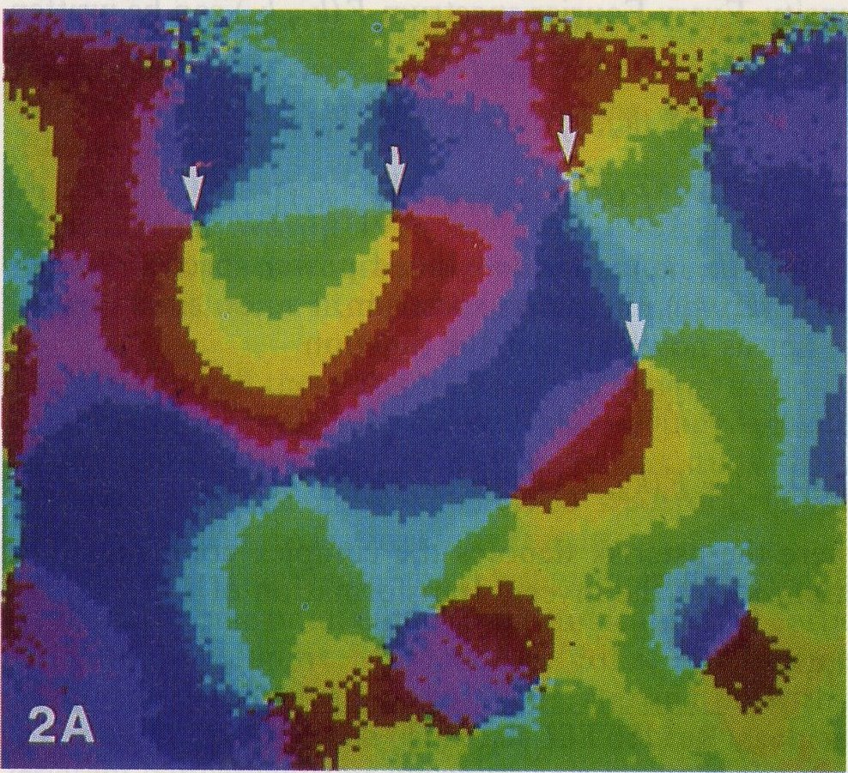
2d Map
Colormap of preferred orientation in the visual cortex of a cat. One dimensional experiments like in the previous slide correspond to an electrode trace indicated by the black arrow. Small white arrows are VERTICES where all orientations meet.

Slide 21
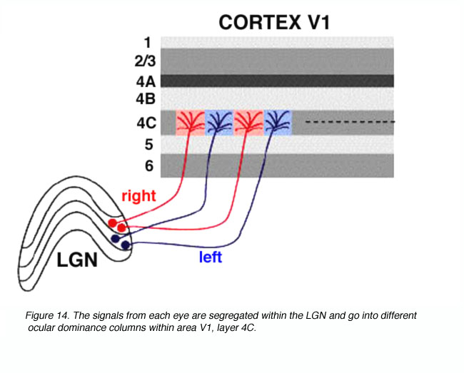
Ocular Dominance Columns
The signals from the left and the right eye remain separated in the LGN. From there they are projected to the primary visual cortex where the cells can either be dominated by one eye (ocular dominance L/R) or have equal input (binocular cells).

Slide 22
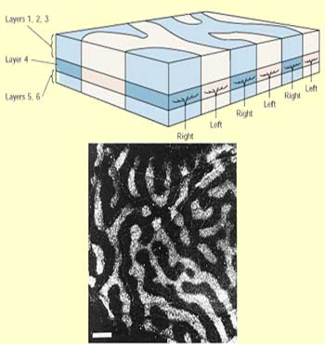
Ocular Dominance Columns
The signals from the left and the right eye remain separated in the LGN. From there they are projected to the primary visual cortex where the cells can either be dominated by one eye (ocular dominance L/R) or have equal input (binocular cells).
White stripes indicate left and black stripes right ocular dominance (coloring with desoxyglucose).

Slide 23
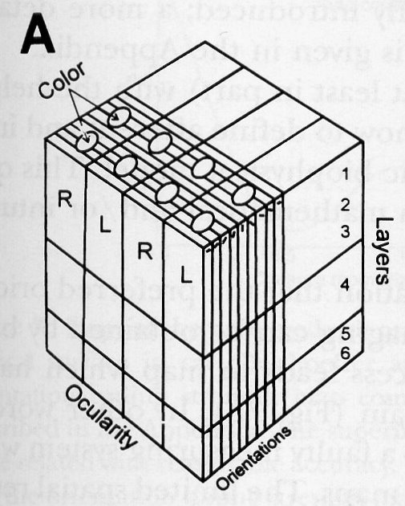
Ice Cube Model
Columns with orthogonal directions for ocularity and orientation.
Hubel and Wiesel, J. of Comp. Neurol., 1972

Slide 24

Ice Cube Model
Columns with orthogonal directions for ocularity and orientation.
Problem: Cannot explain the reversal of the preferred orientation changes and areas of smooth transitions are overestimated (see data).
Hubel and Wiesel, J. of Comp. Neurol., 1972

Slide 25
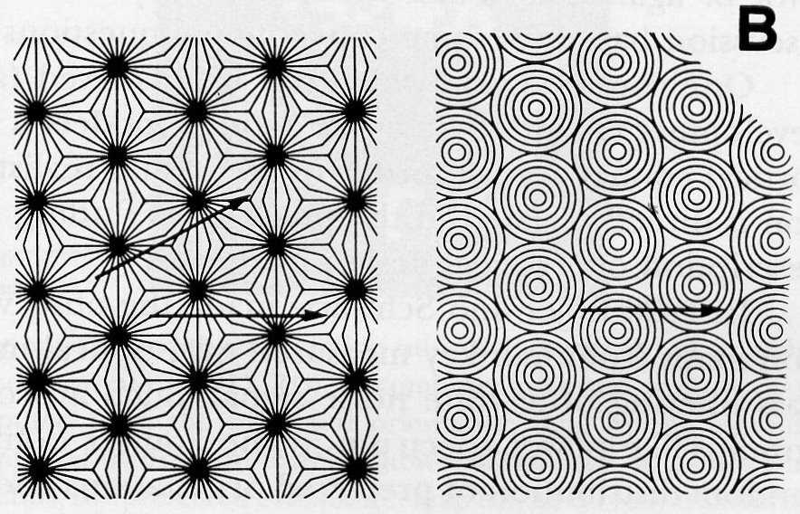
Graphical Models
Preferred orientations are identical to the tangents of the circles/lines. Both depicted models are equivalent.
Vortex: All possible directions meet at one point, the vortex.
Problem: In these models vortices are of order 1, i.e. all directions meet in one point, but 0° and 180° are indistinguishable.
Braitenberg and Braitenberg, Biol.Cybern., 1979

Slide 26

Graphical Models
Preferred orientations are identical to the tangents of the circles/lines. Both depicted models are equivalent.
Vortex: All possible directions meet at one point, the vortex.
Problem: In these models vortices are of order 1, i.e. all directions meet in one point, but 0° and 180° are indistinguishable.
From data: Vortex of order 1/2.
Braitenberg and Braitenberg, Biol.Cybern., 1979

Slide 27
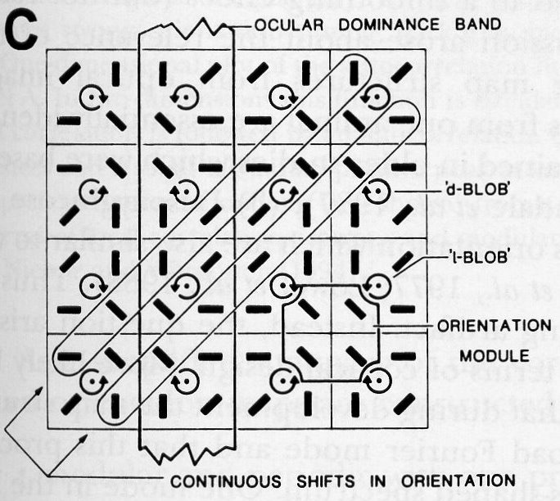
Graphical Models cont'd
In this model all vertices are of order 1/2, or more precise -1/2 (d-blob) and +1/2 (l-blob). Positive values mean that the preferred orientation changes in the same way as the path around the vertex and negative values mean that they change in the opposite way.
Götz, Biol.Cybern., 1988

Slide 28
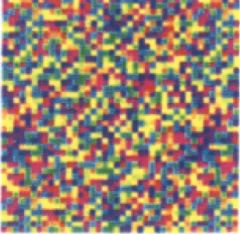
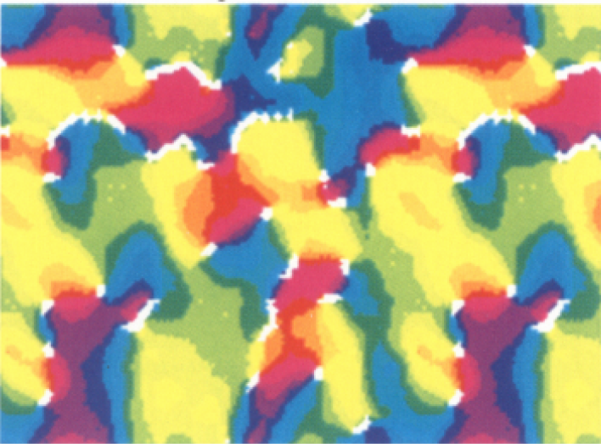
Developmental Models
Start from an equal orientation distribution and develop a map by ways of a developmental algorithm.
Are therefore related to learning and self-organization methods.

Slide 29
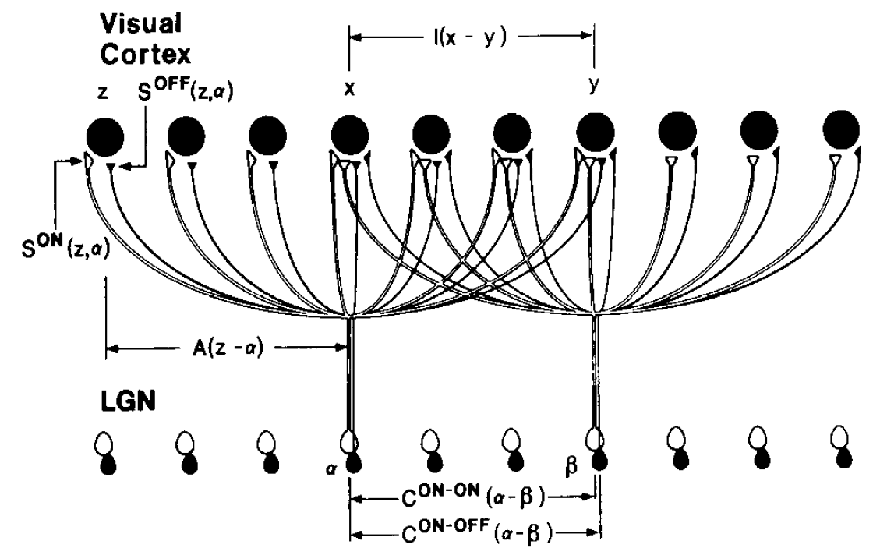
Model based on differences in On-Off responses
ON-cell
OFF-cell
KD Miller, J Neurosci. 1994

Slide 30
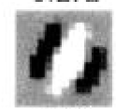
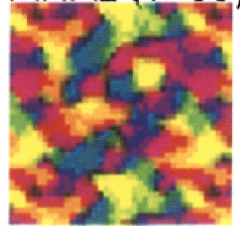
Adapting weights S with a Hebbian rule (~ C^{D}) and normalisation yields:
Resulting receptive fields
C^{ON,ON}
Resulting orientation map
Difference Corre-
lation Function
( C^{ON,ON}-C^{ON,OFF})

Slide 31
Orientation columns in the visual cortex

Slide 32
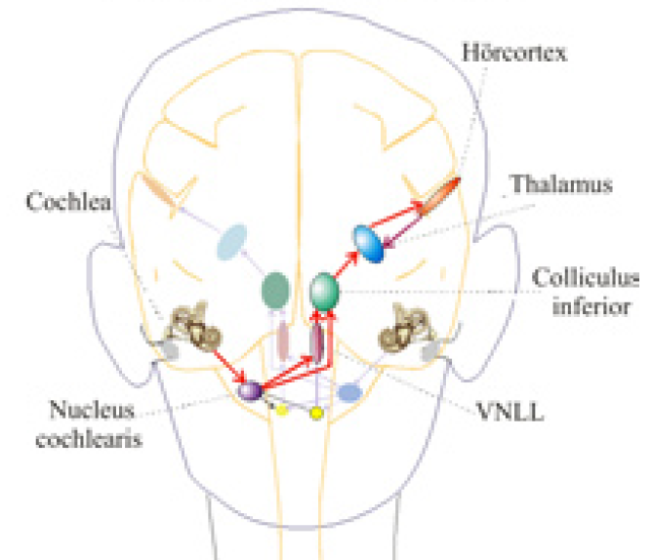
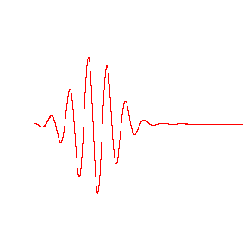
Auditory Maps
Auditory information (air pressure fluctuation) undergo a complex
cascade or transformation before it reaches the brain.
How is the temporal structure of a signal represented in the brain?
The cochlea breaks signal down
into frequency components.

Slide 33
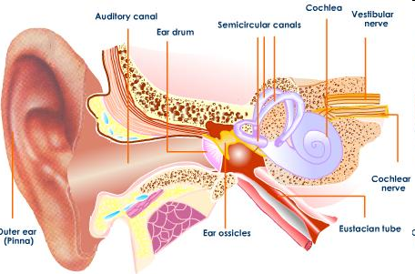
Ear

Slide 34
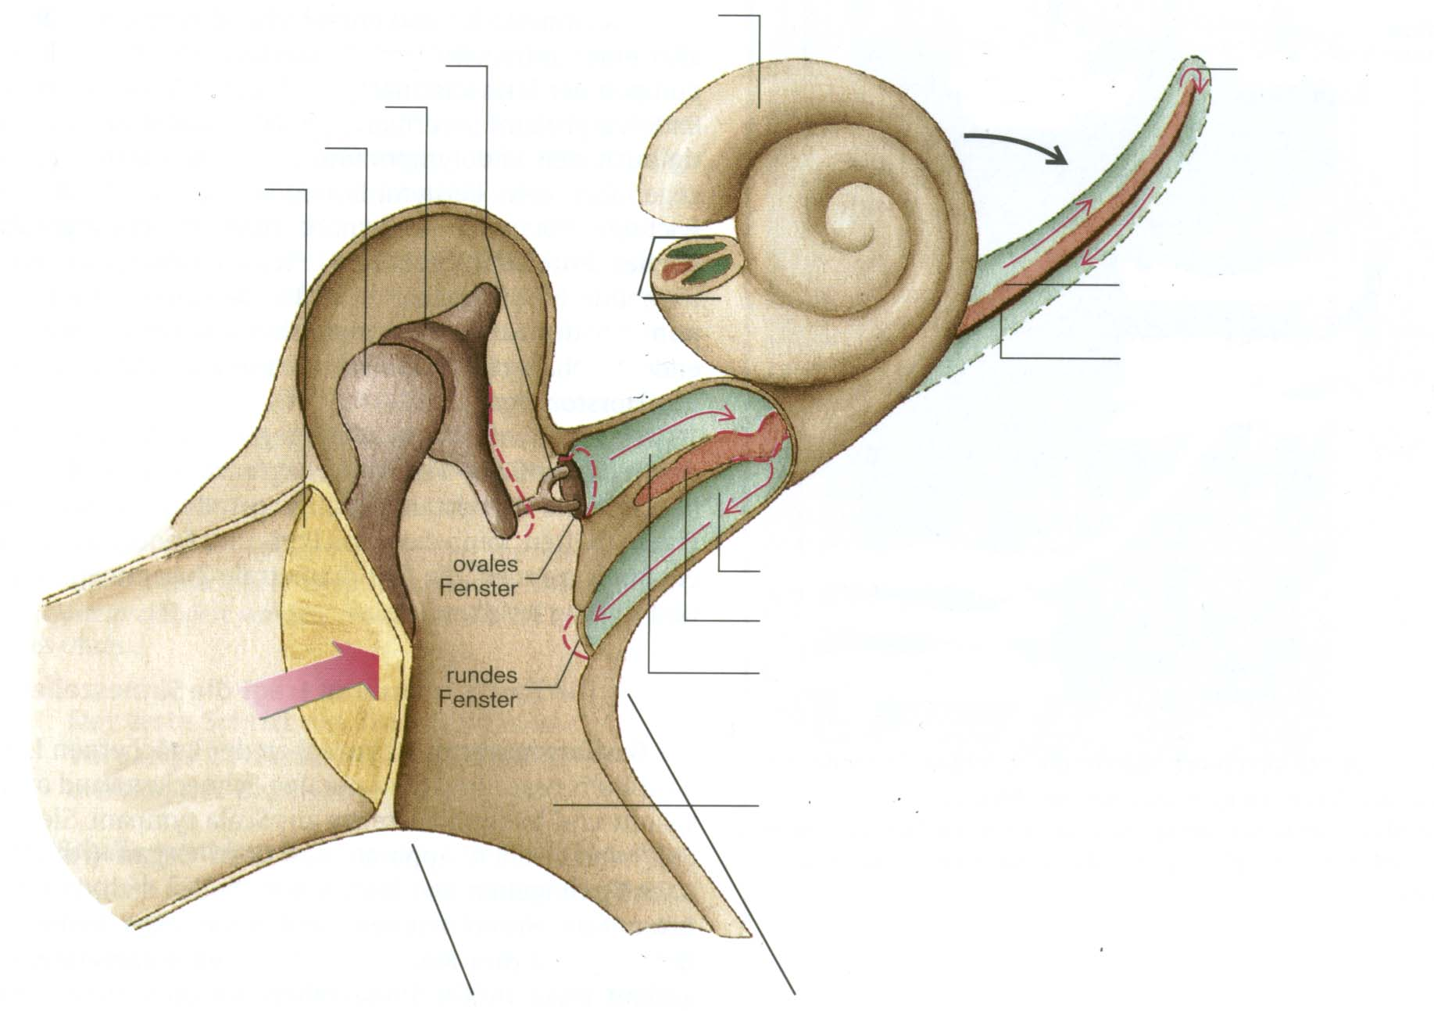
Ear
Hammer, Amboß, Steigbügel
Stapes
Helicotrema
Incus
Apex
Maleus
Eardrum
Reißner-Membrane
Base
Basilarmembrane Corti-Organ
Scala tympani (Perilymphe)
Scala media (Endolymphe)
Scala vestibuli (Perilymphe)
Tuba Eustacchii
Middle ear
External ear
Inner ear

Slide 35
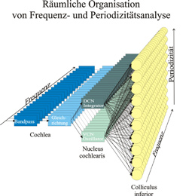
Spacial representation of timbre and pitch
Rectifier
Cochlear acts like a filter bank with parallel channels (blue). Hair cells rectify the signal.
Bandpass

Slide 36
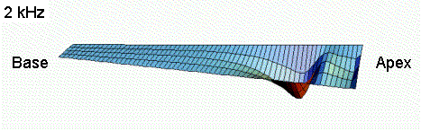
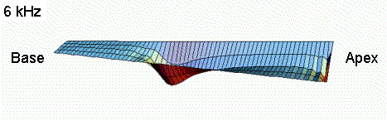
Resonance in the Ear: Cochlea
The Basilar Membrane acts like a resonance body. Resonance occurs – depending on the sound frequency – at different locaction of the Basilar Membrane.
High stiffness of the Basilar Membrane close to the oval window (Base) allows for resonance of high frequencies, whereas low frequencies resonate only close to the Helicotrema (Apex), where the membrane is less stiff.

Slide 37
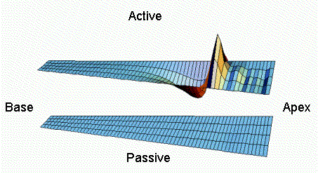
Resonance in the Ear: Cochlea
Look
closely!
In addition to this there is a physiological amplification effect which arises from the outer haircells leading to a focusing of the signal.
Video: Dancing Hair Cell

Slide 38
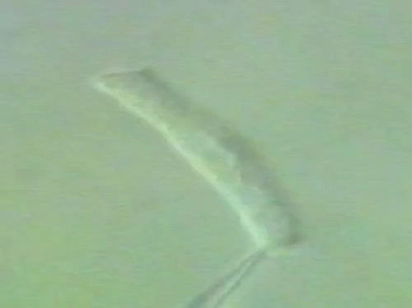
Dancing Haircell
Note: Sounds needs to be switched on for this one

Slide 39
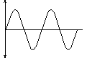
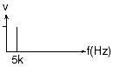
Short Excursion: The Spectrum
Every temporal signal can be
characterized by its spectrum.
The spectrum contains frequency
components.
Important mathematical tool:
Fourier Transform!
- Pure tone => only one
frequency
A
t
sin(2pi*wt)‏
A
w

Slide 40
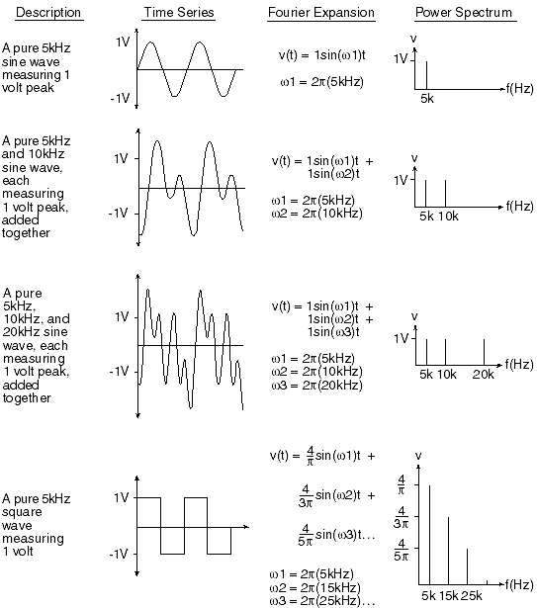
Short Excursion: The Spectrum
Every temporal signal can be
characterized by its spectrum.
The spectrum contains frequency
components.
Important mathematical tool:
Fourier Transform!
- Pure tone => only one
frequency
- Superposition of pure tones =>
all pure tone frequencies
- Square wave => infinite discrete
frequencies with decreasing
amplitudes
- Non periodic signals =>
continuous spectrum

Slide 41
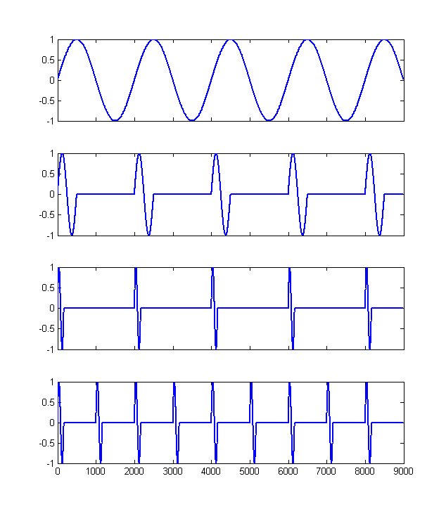
Difference between pitch and frequency
Amplitude
Frequency
Amplitude
Frequency
Amplitude
Both signal have different spectra but the same period (black arrow). The higher frequency components in the lower spectrum are called harmonics.
Frequency
Amplitude
Frequency

Slide 42
Difference between pitch and frequency
All four signals have different frequency spectra and therefore sound differently.
The first three signals have the same period and therefore the same perceived pitch.
The pitch of the fourth signal is higher than the rest, but the sound is similar to the sound of the third signal, since the harmonics are similar.
Note: The pitch of signal 3 and 4 corresponds to the dashed red line. This frequency is not contained in the spectrum.
Amplitude
Frequency
Amplitude
Frequency
Amplitude
Frequency
Amplitude
Frequency

Slide 43
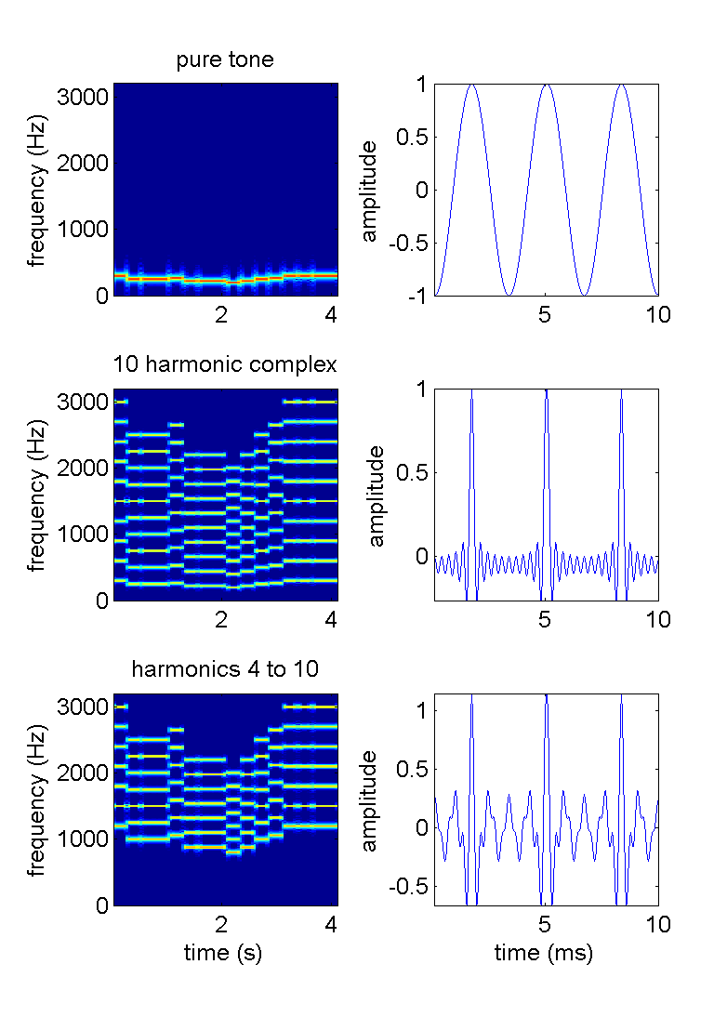

Difference between pitch and frequency

Slide 44
Steps of signal transduction (simplified)‏
1. Cochlea: Spectral and temporal
information transmitted via auditory
nerve to
2. Cochlear Nucleus: Temporal
structure of signal (coincidence
detectors – temporal difference
between left and right ear < 10μs)‏
3. Inferior Colliculus (IC): Two types
of cells – cells with narrow frequency band width and cells with high temp. resolution => spacial map of spectral-temporal information.
4. Cortex: Orthogonal Map of frequency content (Tonotopy) and
pitch (Periodotopy)‏

Slide 45
Spacial representation of timbre and pitch
Rectifier
Cochlear acts like a filter bank with parallel channels (blue). Hair cells rectify the signal.
Bandpass

Slide 46
Spacial representation of timbre and pitch
DCN
Integrator
Rectifier
Cochlear acts like a filter bank with parallel channels (blue). Hair cells rectify the signal.
Dorsal chochlear nucleus (green, DCN) transfers periodic signals with different delays.
Bandpass

Slide 47
Spacial representation of timbre and pitch
DCN
Integrator
Rectifier
Cochlear acts like a filter bank with parallel channels (blue). Hair cells rectify the signal.
Dorsal chochlear nucleus (green, DCN) transfers periodic signals with different delays.
Ventral chochlear nucleus (green, VCN) transfers periodic signals without delays.
Bandpass
VCN
Oscillator

Slide 48
Spacial representation of timbre and pitch
DCN
Integrator
Rectifier
Cochlear acts like a filter bank with parallel channels (blue). Hair cells rectify the signal.
Dorsal chochlear nucleus (green, DCN) transfers periodic signals with different delays.
Ventral chochlear nucleus (green, VCN) transfers periodic signals without delays.
Coincidence neurons in the inferior colliculus (yellow, IC) respond best whenever the delay in their DCN input is compensated by the signal period.
Bandpass
VCN
Oscillator
IC
Coincidence Detection

Slide 49
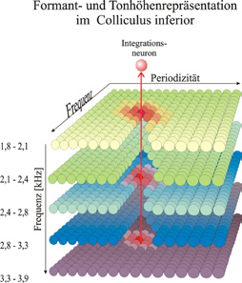
Layer model of orthogonal representation of pitch
and frequency in the IC
Integration Neuron
Each of the 5 depicted layers (total ~30) is tuned to a narrow frequency band and a large periodicity range (values on the left obtained from cats)‏
Each lamina has a frequency gradient for tonotopic fine structure orthogonal to pitch
Response to a signal with three formants (three different frequency components)‏
Orthogonal connections between layers are assumed to integrate pitch information (red arrow).

Slide 50
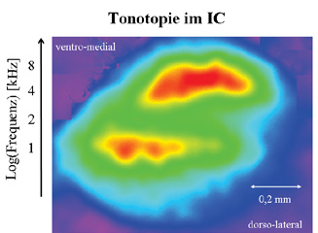
Layer model of orthogonal representation of pitch
and frequency in the IC
dorso-lateral
Integration Neuron
Each of the 5 depicted layers (total ~30) is tuned to a narrow frequency band and a large periodicity range (values on the left obtained from cats)‏
Each lamina has a frequency gradient for tonotopic fine structure orthogonal to pitch
Response to a signal with three formants (three different frequency components)‏
Orthogonal connections between layers are assumed to integrate pitch information (red arrow).
ventro-medial
Response of brain slice to pure tones with 1 kHz and 8 kHz

Slide 51
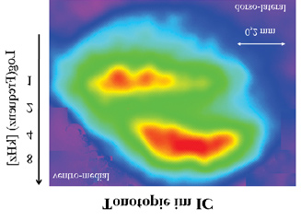
Layer model of orthogonal representation of pitch
and frequency in the IC
dorso-lateral
Integration Neuron
ventro-medial
Response of brain slice to pure tones with 1 kHz and 8 kHz

Slide 52
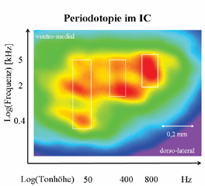
Layer model of orthogonal representation of pitch
and frequency in the IC
Integration Neuron
Each of the 5 depicted layers (total ~30) is tuned to a narrow frequency band and a large periodicity range (values on the left obtained from cats, ~0.6 octaves/layer)‏
Each lamina has a frequency gradient for tonotopic fine structure orthogonal to pitch
Response to a signal with three formants (three different frequency components)‏
Orthogonal connections between layers are assumed to integrate pitch information (red arrow).
Response to 3 harmonic signals with pitches (50, 400, 800)Hz and frequency ranges of (0.4-5, 2-5, 3.2-8) kHz (white rectangles).
Vertical bands correspond to log arrangement of fundamental frequencies.
Response of brain slice to pure tones with 1 kHz and 8 kHz
LOG(pitch)‏

Slide 53
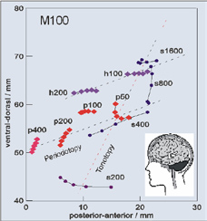
Orthogonality of frequency and pitch in humans
MEG investigation in humans using stimuli with pitch ranging from 50 – 400 Hz (red and purple diamonds) and frequencies ranging from 200 – 1600 Hz (black points).
Each point marks the position of maximum cortical activity in a 2ms window (5 points = 10ms), 100ms after the signal is switched on.
Tonotopical and periodotopical axes can be defined which are orthogonal to each other.
Position of the response along the tonotopic axis corresponds to the lower cut-off frequency of the broadband harmonic sounds (red 400Hz, purple 800Hz).
down
sideways
sideways

Slide 54
Orthogonality of frequency and pitch in humans
MEG investigation in humans using stimuli with pitch ranging from 50 – 400 Hz (red and purple diamonds) and frequencies ranging from 200 – 1600 Hz (black points).
Each point marks the position of maximum cortical activity in a 2ms window (5 points = 10ms), 100ms after the signal is switched on.
Tonotopical and periodotopical axes can be defined which are orthogonal to each other.
Position of the response along the tonotopic axis corresponds to the lower cut-off frequency of the broadband harmonic sounds (red 400Hz, purple 800Hz).
Our ability to differentiate spoken and musical sounds is based on the fact that our hearing splits up signals into frequencies, pitches and harmonics in such a way that spectral and temporal information can be mapped to the cortex very reliably.

